Slide 1

Dungeons & Dragons Character Storage
By, Jacob Anderson

Slide 2


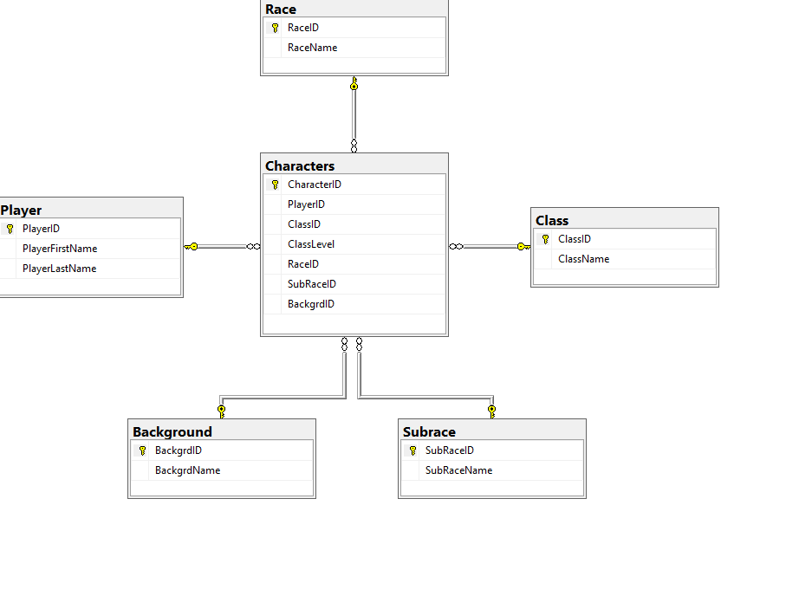
Database Diagram

Slide 3

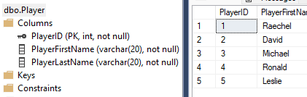
Player Table

Slide 4
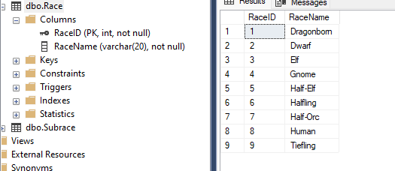
Race Table

Slide 5
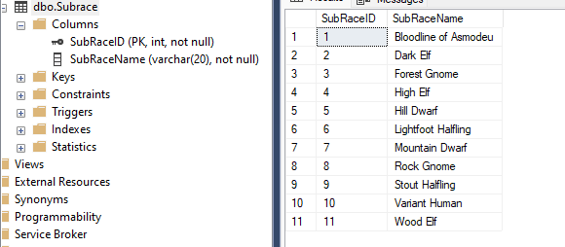
Subrace Table

Slide 6
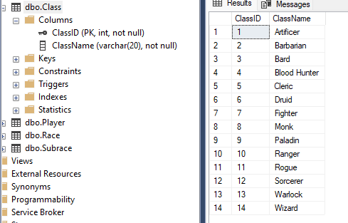
Class Table

Slide 7
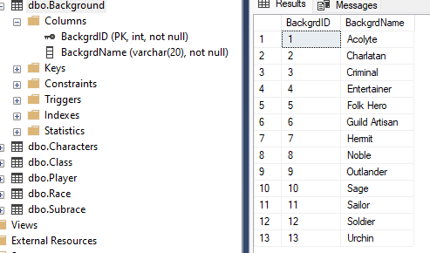
Background Table

Slide 8
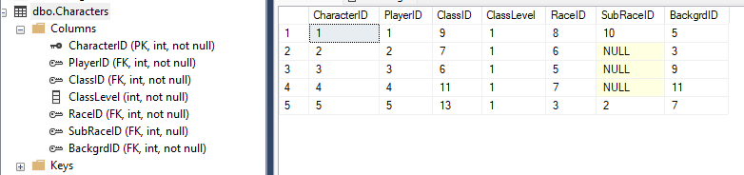
Character Table

Slide 9
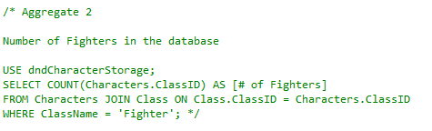
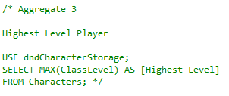
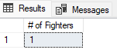
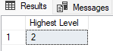
Summary Queries
First
Second

Slide 10
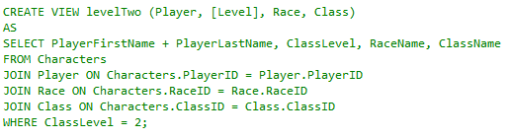
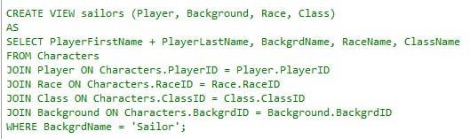
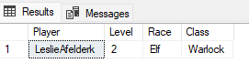
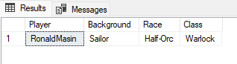
Views
First
Second

Slide 11
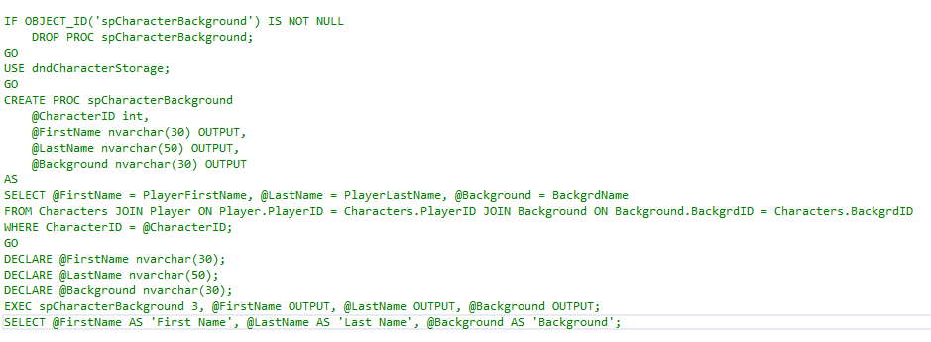
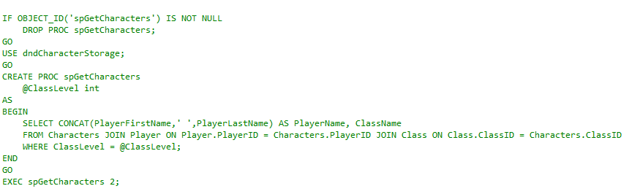
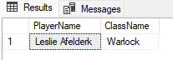
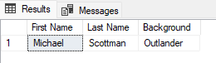
Stored Procedures
First
Second

Slide 12
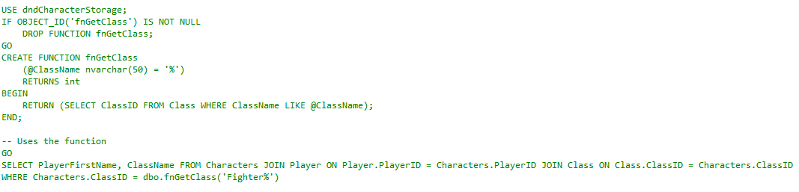
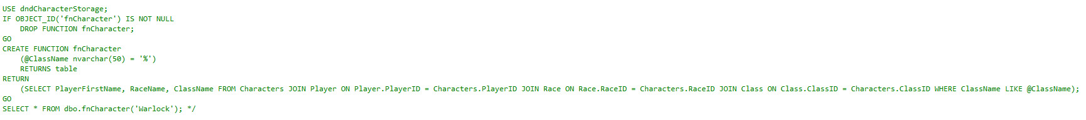
Functions
First
The first function selects the first name of any players who have a character in the fighter class. (It also displays the class name)
Second
The second function selects the first name of the player and the character’s race for any character in the warlock class. (It also displays the class name)

Slide 13
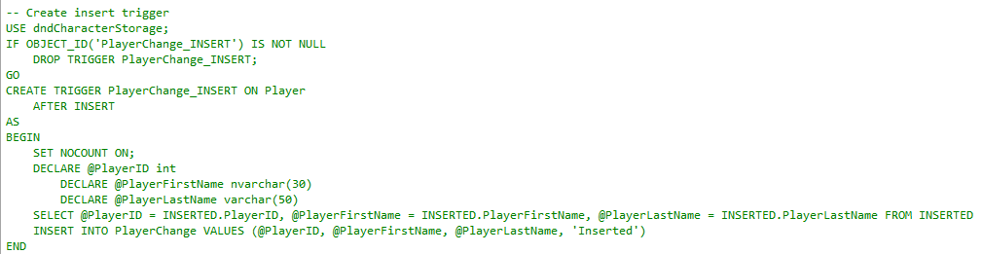
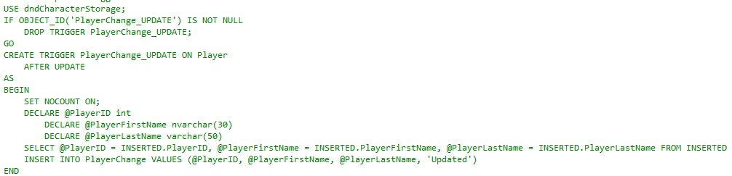
Triggers
First
The first trigger stores inserted rows into a table called ‘PlayerChange’ and labels the row as inserted.
Second
The second trigger stores updated rows into a table called ‘PlayerChange’ and labels the row as updated.

Slide 14
What Went Well
What Problems I Ran Into
It was very easy to come up with things that I wanted to select or display and it was fun sorting all of my data. I had to get a little creative because in my character table I only had numbers and that would be boring.
I had a hard time updating and deleting rows sometimes because the way I had it setup I could not get rid of a player if they had a character. I ended up having to create a characterless player to delete.
What I Learned
What I Would Include In The Future
I learned how use multiple tables to display information and how to sort database information into something easily readable.
I would definitely try to find another way to store characters together, because it would be better if a single character could have multiple classes that each have a different level and if each player could have multiple characters.

